Slide 1
Emission scenarios
Silvia Caldararu
Email: caldaras@tcd.ie

Slide 2
General model structure
Emission scenarios
Process representation
Atmosphere
Ocean
Initial conditions
Land surface
Sea ice
Model predictions
Model parameters

Slide 3
The only input for a fully coupled Earth System Model is solar radiation at the top of the atmosphere
Earth System Model
Atmosphere
Ocean
Land surface
Sea ice
And whatever it is that humans are doing

Slide 4
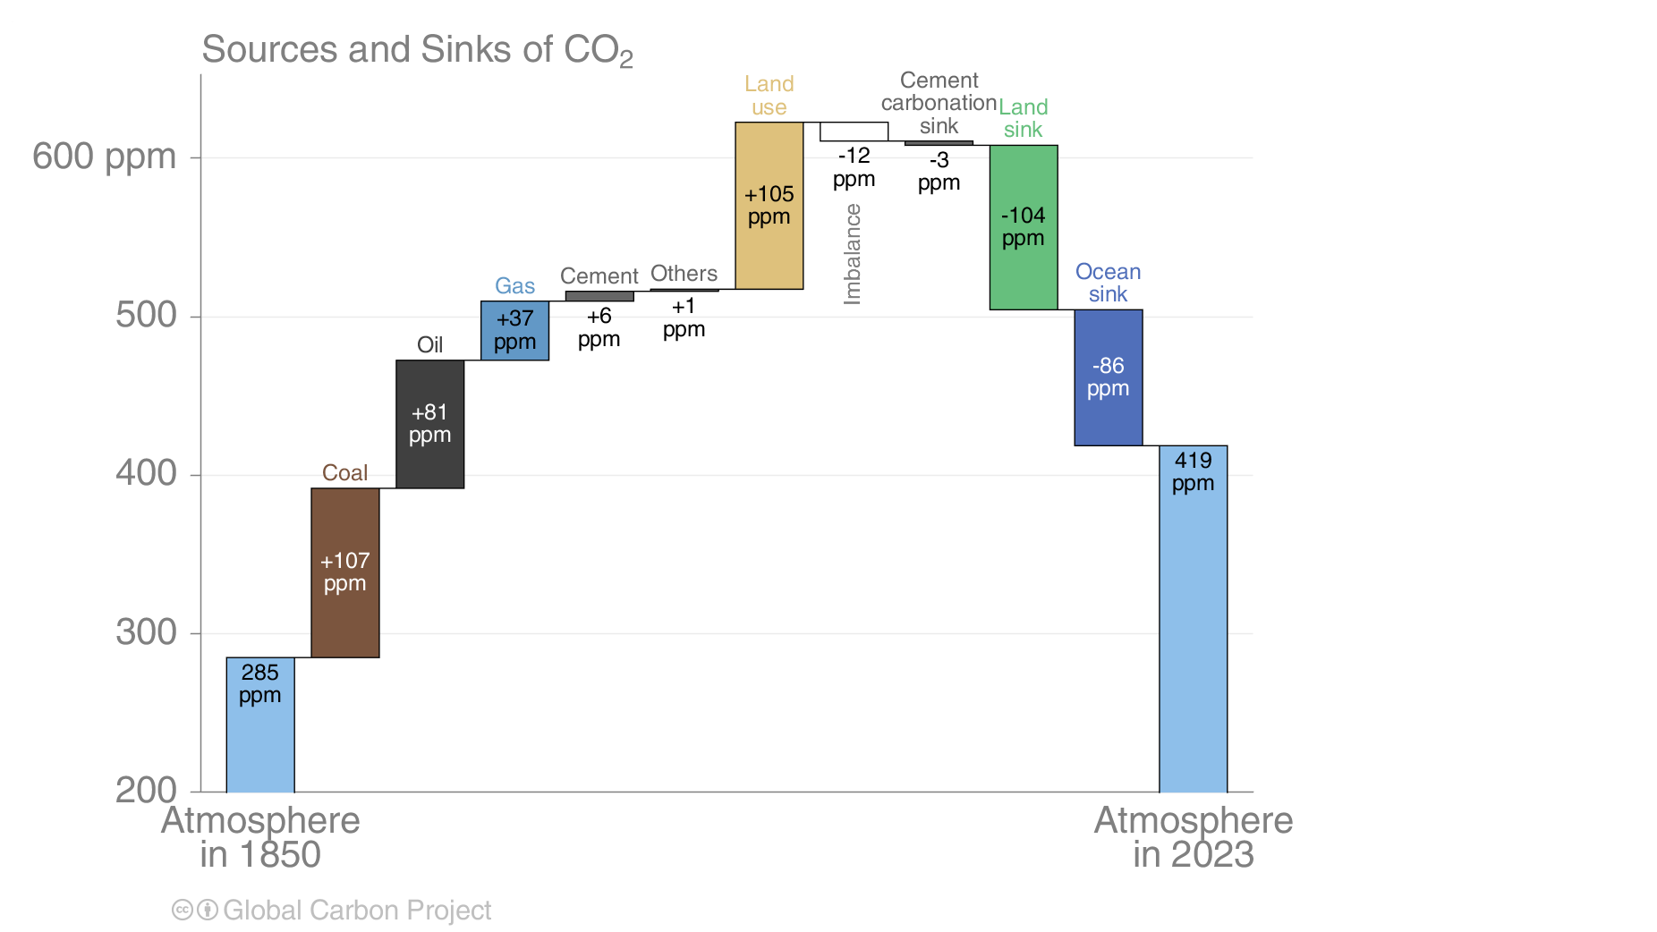

Slide 5
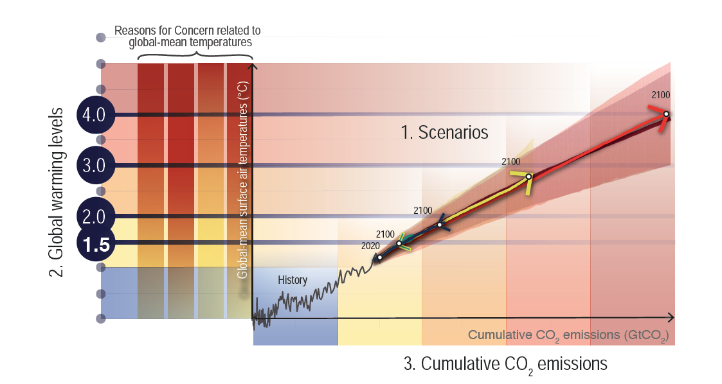
Emissions – temperature - risk
Notes:
IPCC AR6 WG I, chapter 1 Figure 1.24

Slide 6
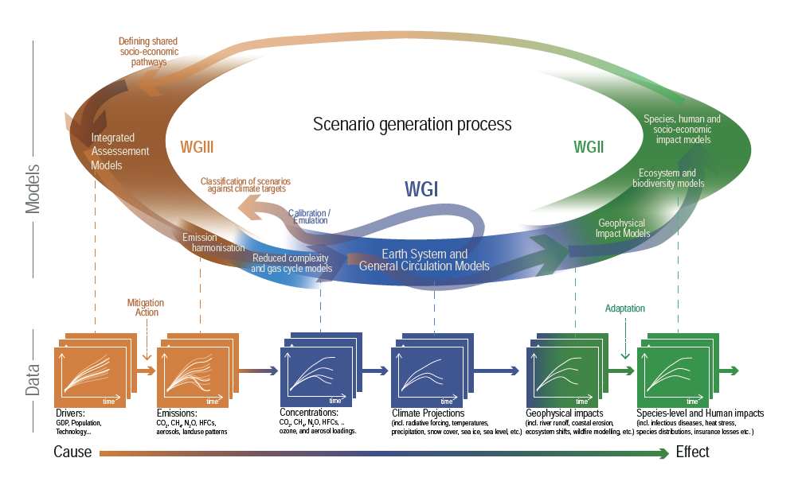

Slide 7
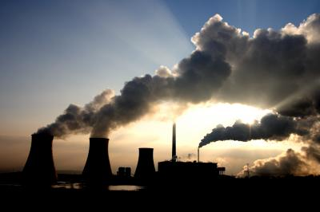
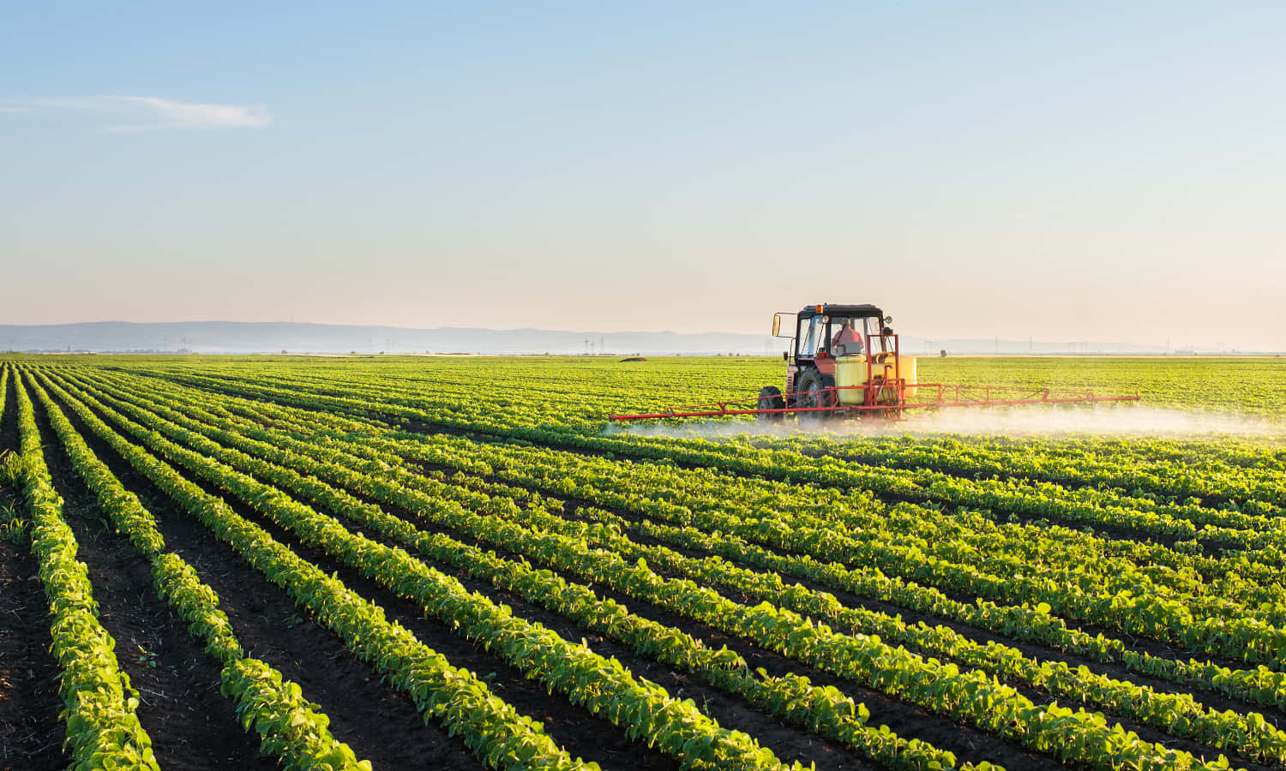

Transition from emissions (AR1-5) to narratives (AR6)
Representative concentration pathways (RCPs)
Emissions, GHG concentrations in the atmosphere
Shared socio-economic pathways (SSPs)
Emissions, land use, global relations, economy

Slide 8
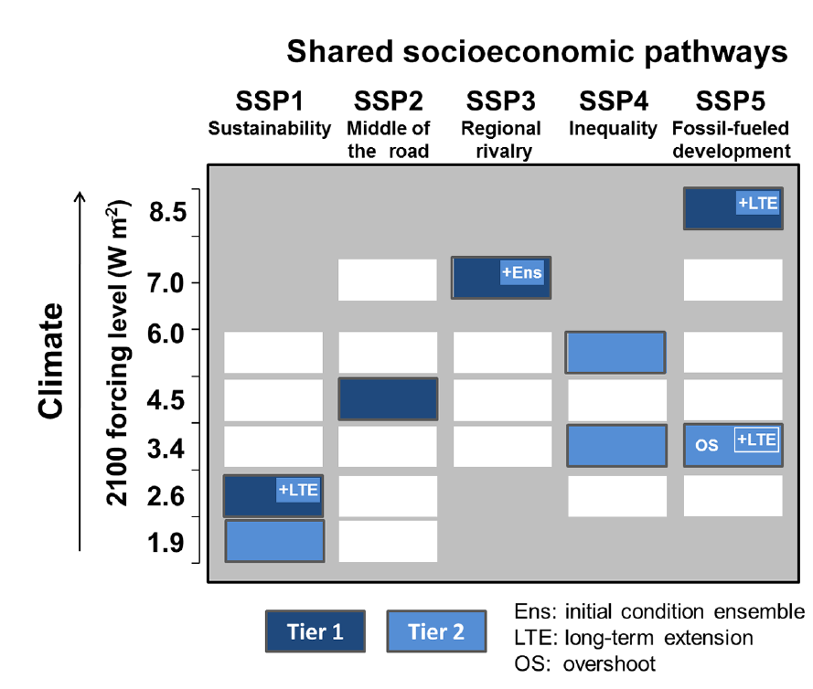
Shared socioeconomic pathways
Notes:
IPCC WG I, chapter 1, Box 1.4 AND O’Neill, B. C., Tebaldi, C., van Vuuren, D. P., Eyring, V., Friedlingstein, P., Hurtt, G., Knutti, R., Kriegler, E., Lamarque, J.-F., Lowe, J., Meehl, G. A., Moss, R., Riahi, K., & Sanderson, B. M. (2016). The Scenario Model Intercomparison Project (ScenarioMIP) for CMIP6. Geoscientific Model Development, 9(9), 3461–3482. https://doi.org/10.5194/gmd-9-3461-2016

Slide 9
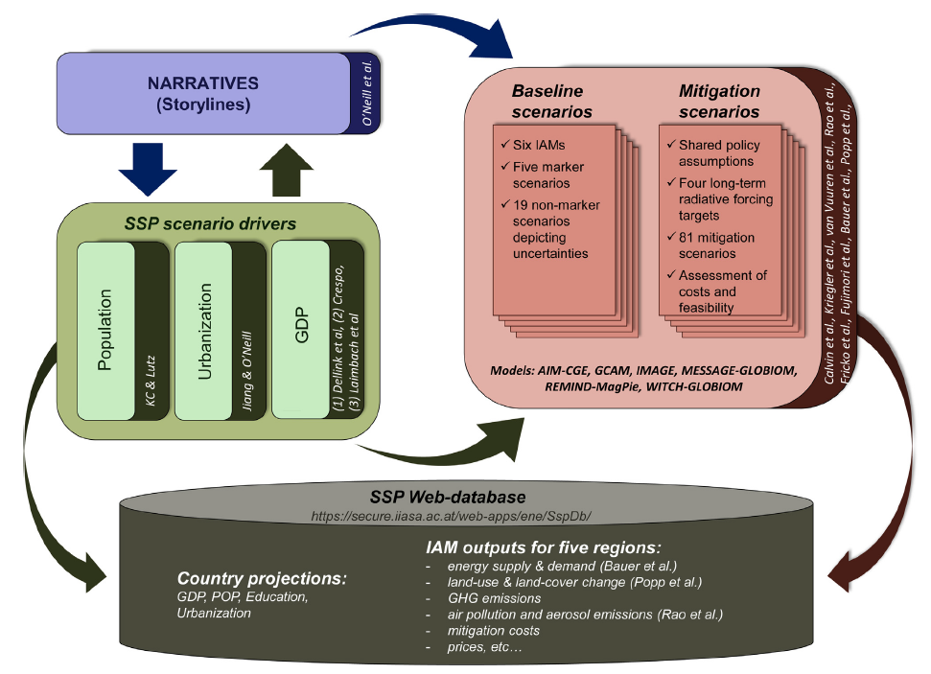
SSP methodology

Slide 10
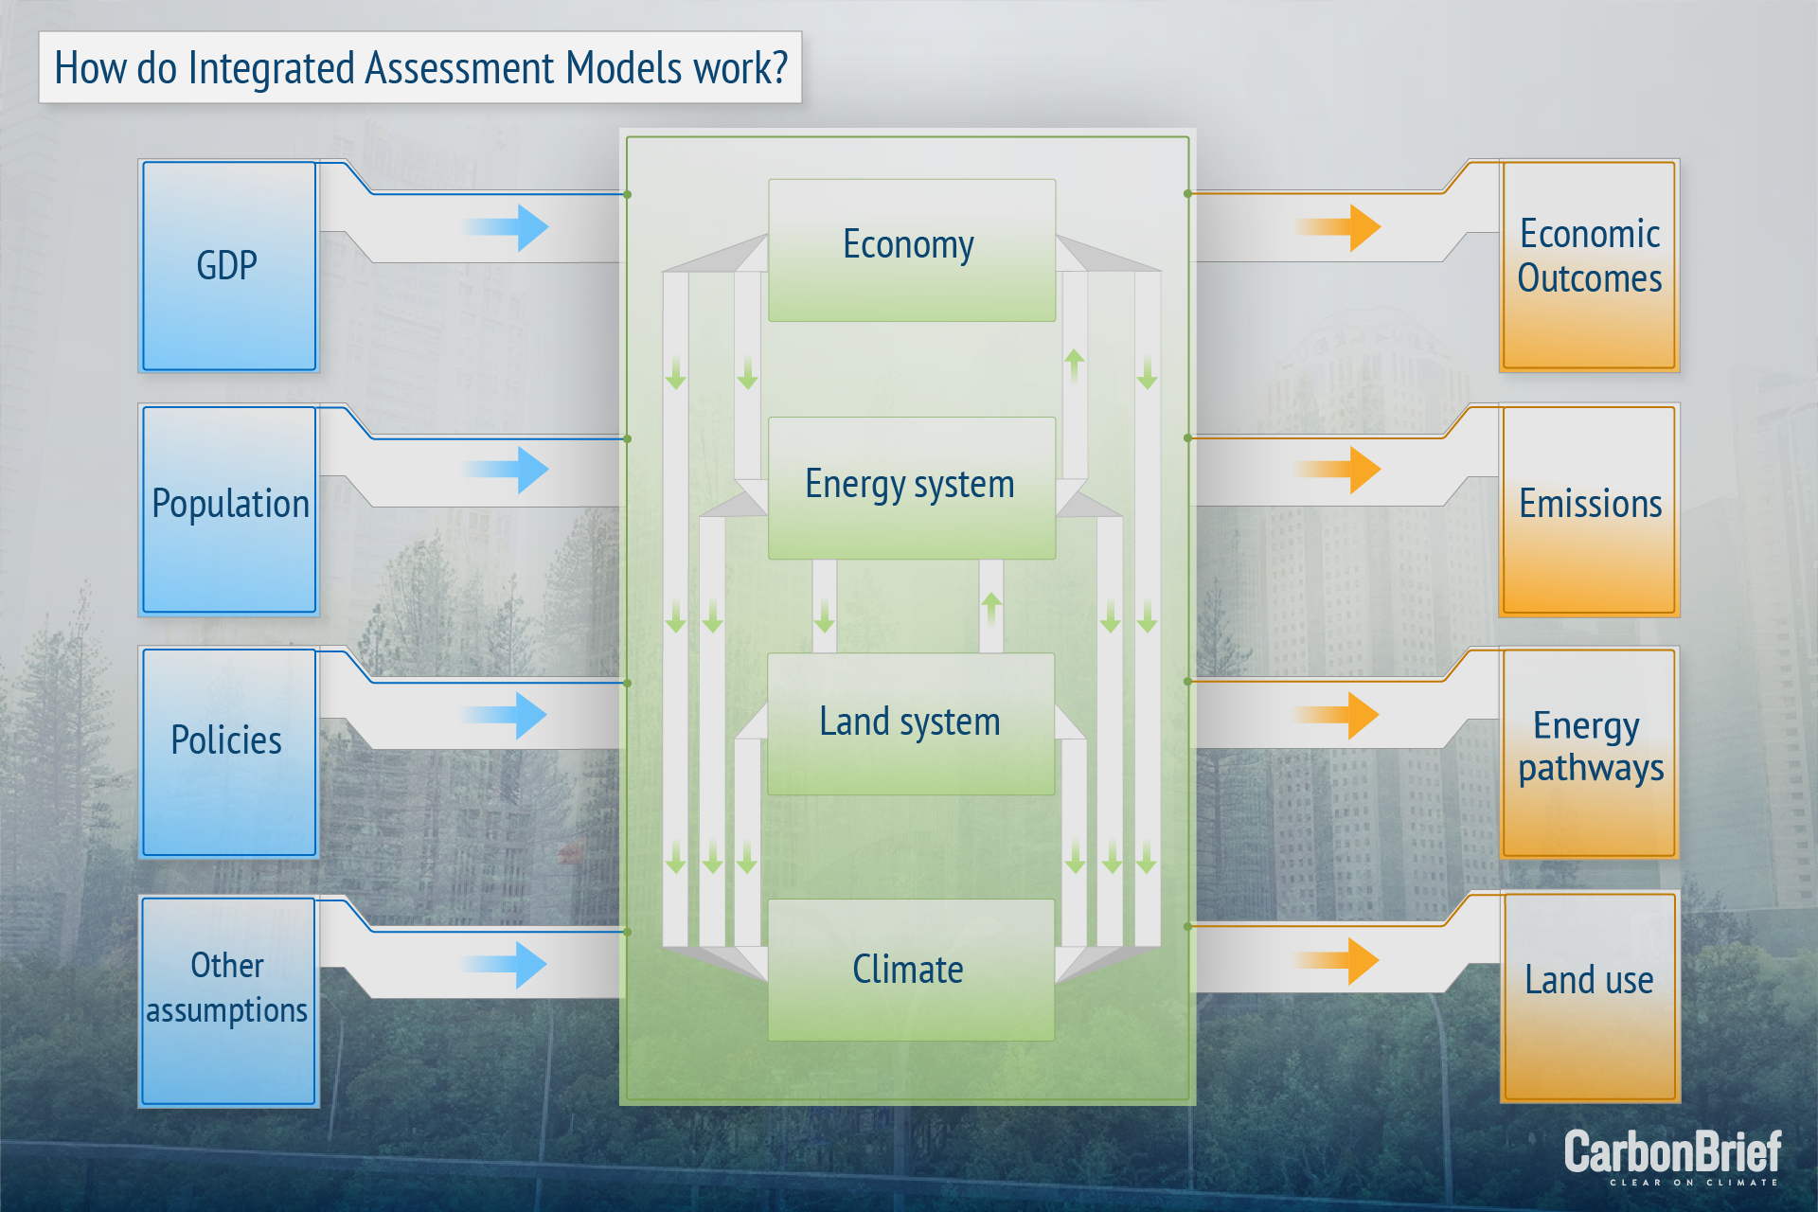
Integrated assessment models (IAMs)

Slide 11

SSP1: Sustainability. Taking the Green Road
The world shifts gradually, but pervasively, toward a more sustainable path, emphasizing more inclusive development that respects perceived environmental boundaries.
Management of the global commons slowly improves, educational and health investments accelerate the demographic transition, and the emphasis on economic growth shifts toward a broader emphasis on human well-being.
Driven by an increasing commitment to achieving development goals, inequality is reduced both across and within countries. Consumption is oriented toward low material growth and lower resource and energy intensity.

Slide 12
SSP2: Middle of the road
The world follows a path in which social, economic, and technological trends do not shift markedly from historical patterns.
Development and income growth proceeds unevenly, with some countries making relatively good progress while others fall short of expectations.
Global and national institutions work toward but make slow progress in achieving sustainable development goals.
Environmental systems experience degradation, although there are some improvements and overall the intensity of resource and energy use declines.
Global population growth is moderate and levels off in the second half of the century

Slide 13
SSP3: Regional Rivalry – A Rocky Road
A resurgent nationalism, concerns about competitiveness and security, and regional conflicts push countries to increasingly focus on domestic or, at most, regional issues.
Policies shift over time to become increasingly oriented toward national and regional security issues. Countries focus on achieving energy and food security goals within their own regions at the expense of broader-based development.
Investments in education and technological development decline. Economic development is slow, consumption is material-intensive, and inequalities persist or worsen over time.
Population growth is low in industrialized and high in developing countries. A low international priority for addressing environmental concerns leads to strong environmental degradation in some regions.

Slide 14
SSP4: Inequality – A Road Divided
Highly unequal investments in human capital, combined with increasing disparities in economic opportunity and political power, lead to increasing inequalities and stratification both across and within countries.
Over time, a gap widens between an internationally-connected society that contributes to knowledge- and capital-intensive sectors of the global economy, and a fragmented collection of lower-income, poorly educated societies that work in a labour intensive, low-tech economy.
Social cohesion degrades and conflict and unrest become increasingly common. Technology development is high in the high-tech economy and sectors.
The globally connected energy sector diversifies, with investments in both carbon-intensive fuels like coal and unconventional oil, but also low-carbon energy sources.

Slide 15
SSP5: Fossil fuelled development – Taking the Highway
This world places increasing faith in competitive markets, innovation and participatory societies to produce rapid technological progress and development of human capital as the path to sustainable development. Global markets are increasingly integrated.
There are also strong investments in health, education, and institutions to enhance human and social capital. At the same time, the push for economic and social development is coupled with the exploitation of abundant fossil fuel resources and the adoption of resource and energy intensive lifestyles around the world.
All these factors lead to rapid growth of the global economy, while global population peaks and declines in the 21st century.
Local environmental problems like air pollution are successfully managed. There is faith in the ability to effectively manage social and ecological systems, including by geo-engineering if necessary.

Slide 16
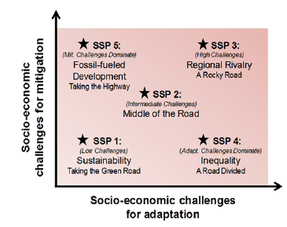
SSPs combine climate mitigation and adaptation challenges

Slide 17
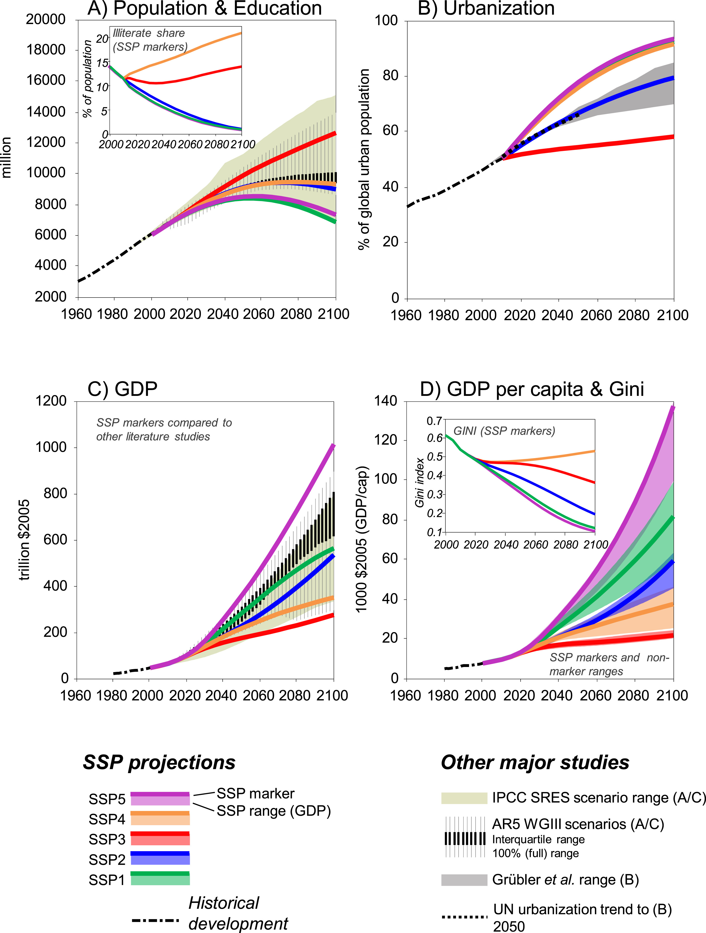
Human population metrics

Slide 18
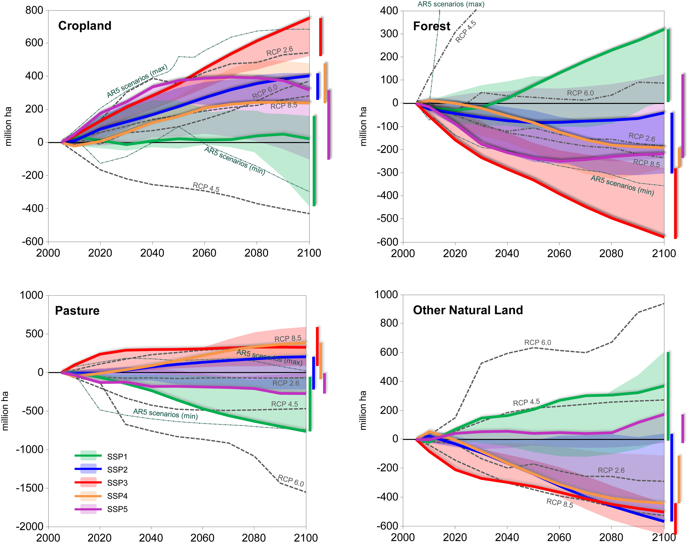
Land use metrics

Slide 19
General model structure
Emission scenarios
Models need emissions and concentrations of GHG
Process representation
Atmosphere
Ocean
Initial conditions
Land surface
Sea ice
Model predictions
Model parameters

Slide 20
SSPs for earth system models
Mitigation, climate outcomes, impacts, adaptation
Different pathways to similar forcing levels
Global and regional differences

Slide 21
SSPs for earth system models

Slide 22
Radiative forcing levels
IPCC definition:
‘the change in net (down minus up) irradiance (solar plus longwave; in W m–2) at the tropopause after allowing for stratospheric temperatures to readjust to radiative equilibrium, but with surface and tropospheric temperatures and state held fixed at the unperturbed values’.
Radiative forcing for all GHGs together in 2100

Slide 23
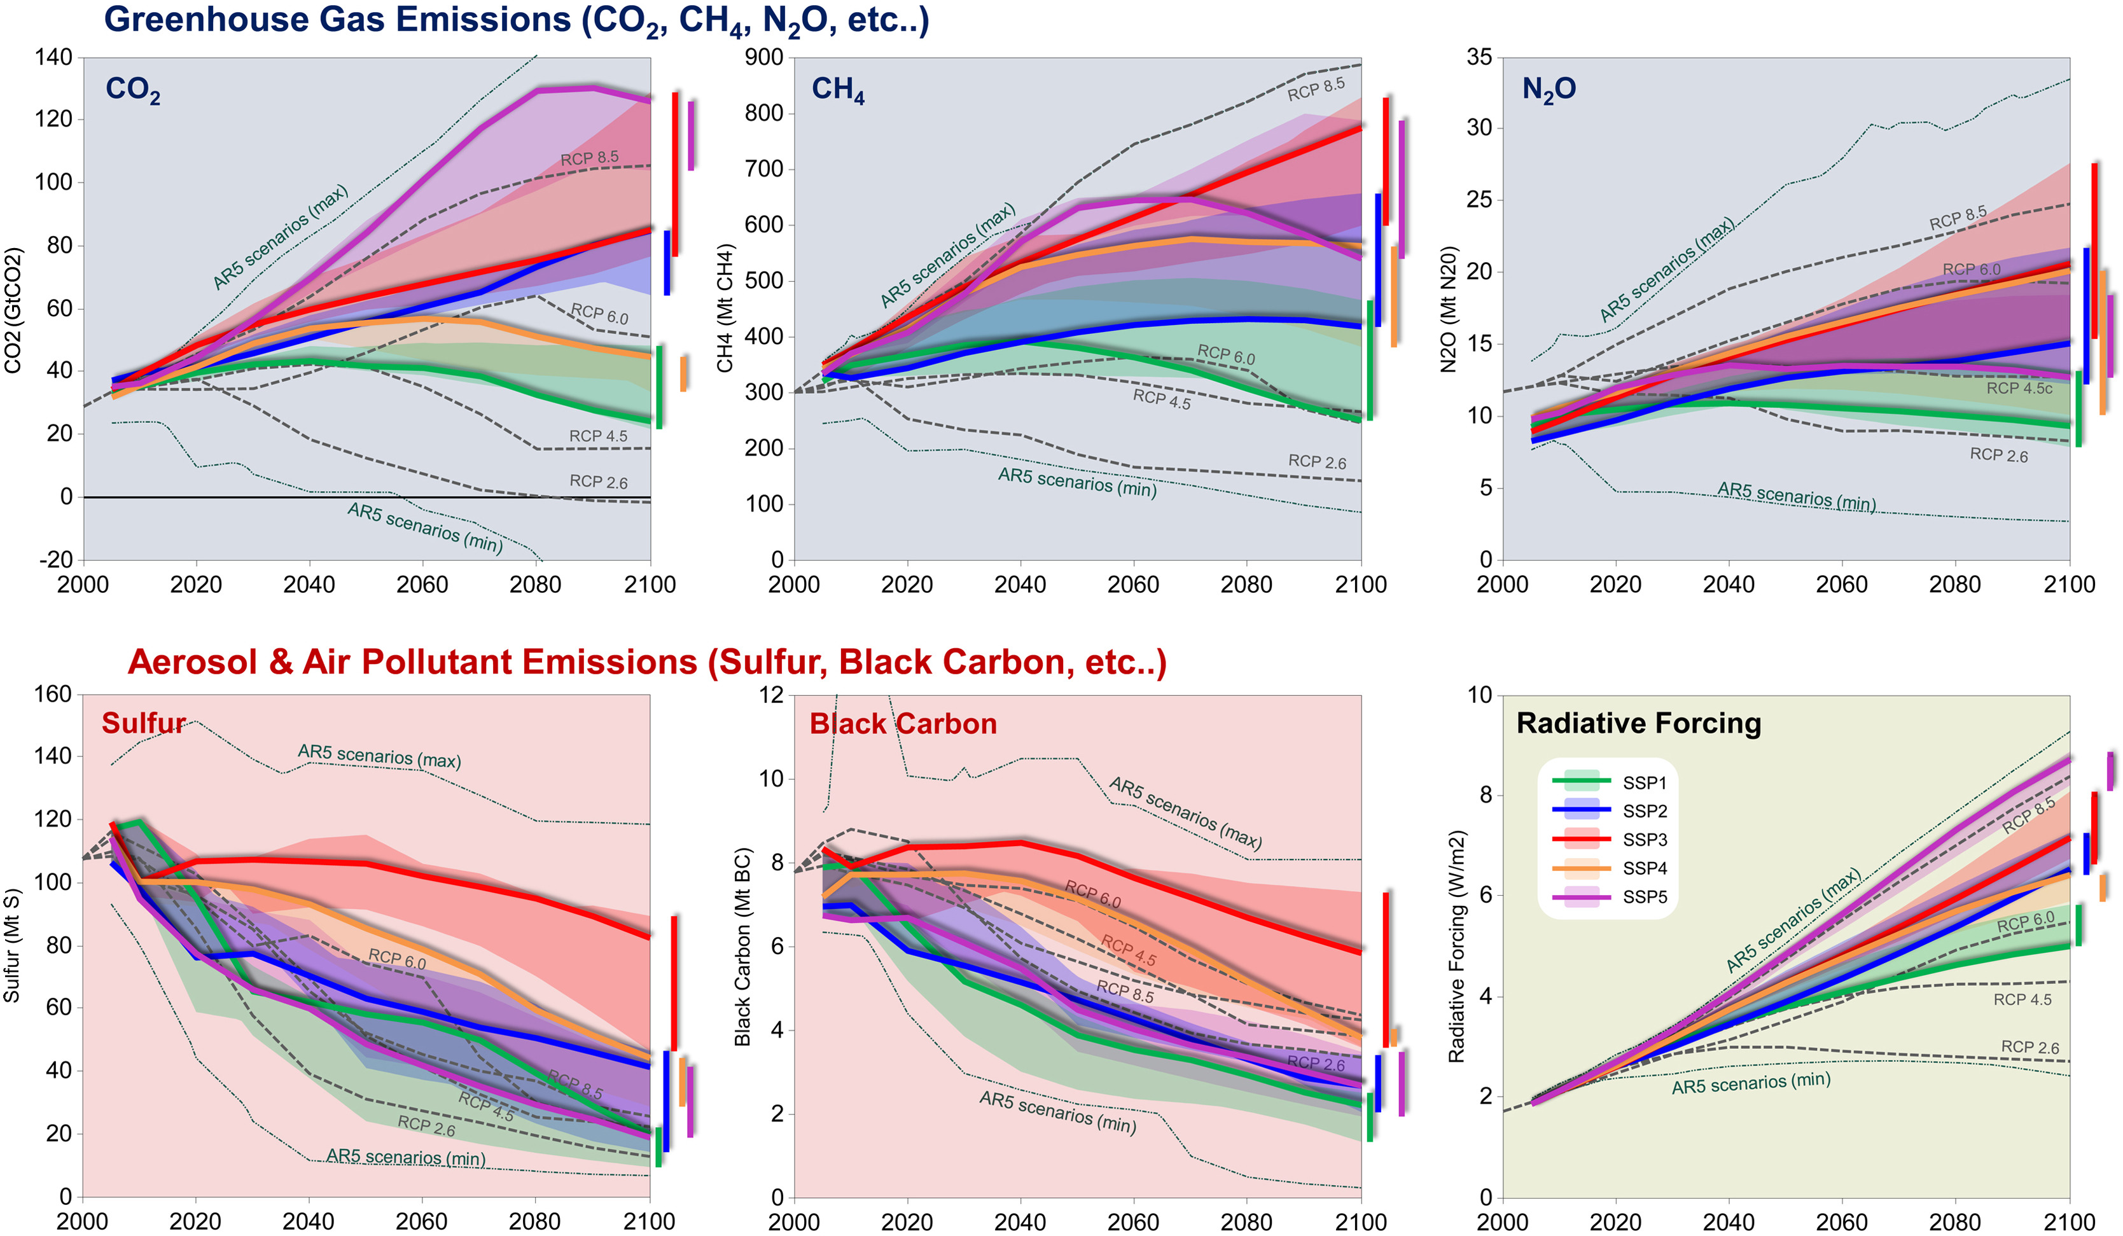
GHG emissions

Slide 24
Only some SSPs used for model projections
Tier 1- used by all models
Tier 2 – used by a subset of models

Slide 25
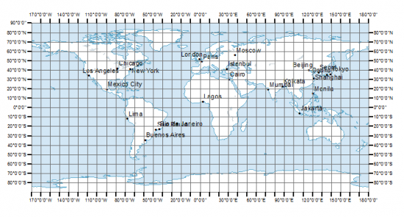
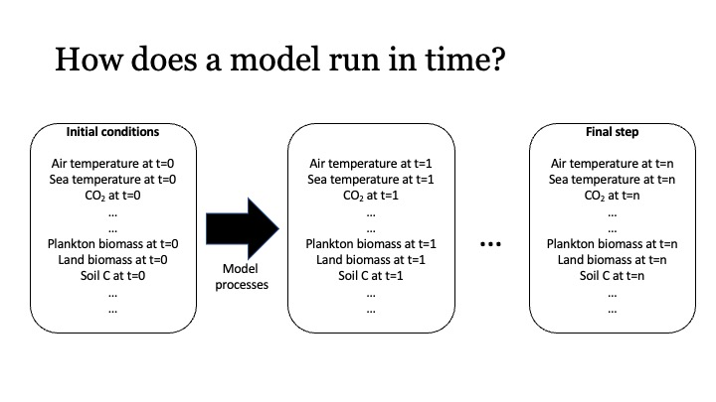
Land use input for ESMs
Information on land use class at each grid cell at each timestep
Not directly calculated in the models
Informs model parameters and processes

Slide 26
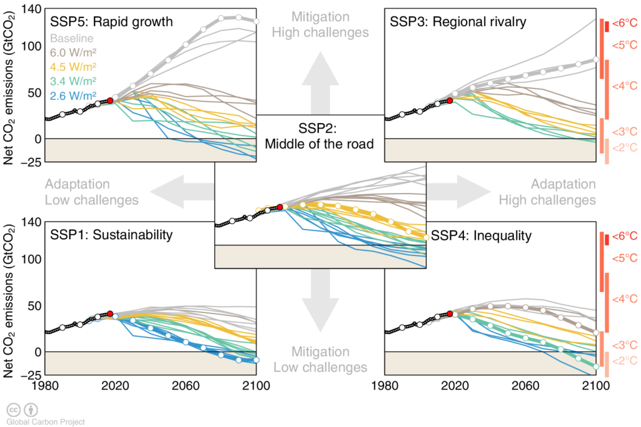
Multiple scenarios used for WG 3 report on mitigation

Slide 27
All scenarios are considered equally probable
Reference/baseline scenarios: SSP3-7.0 and SSP5-8.5
Scenarios with no climate policies
Not realistic given the policies already implemented
But who knows? Don’t underestimate human stupidity

Slide 28
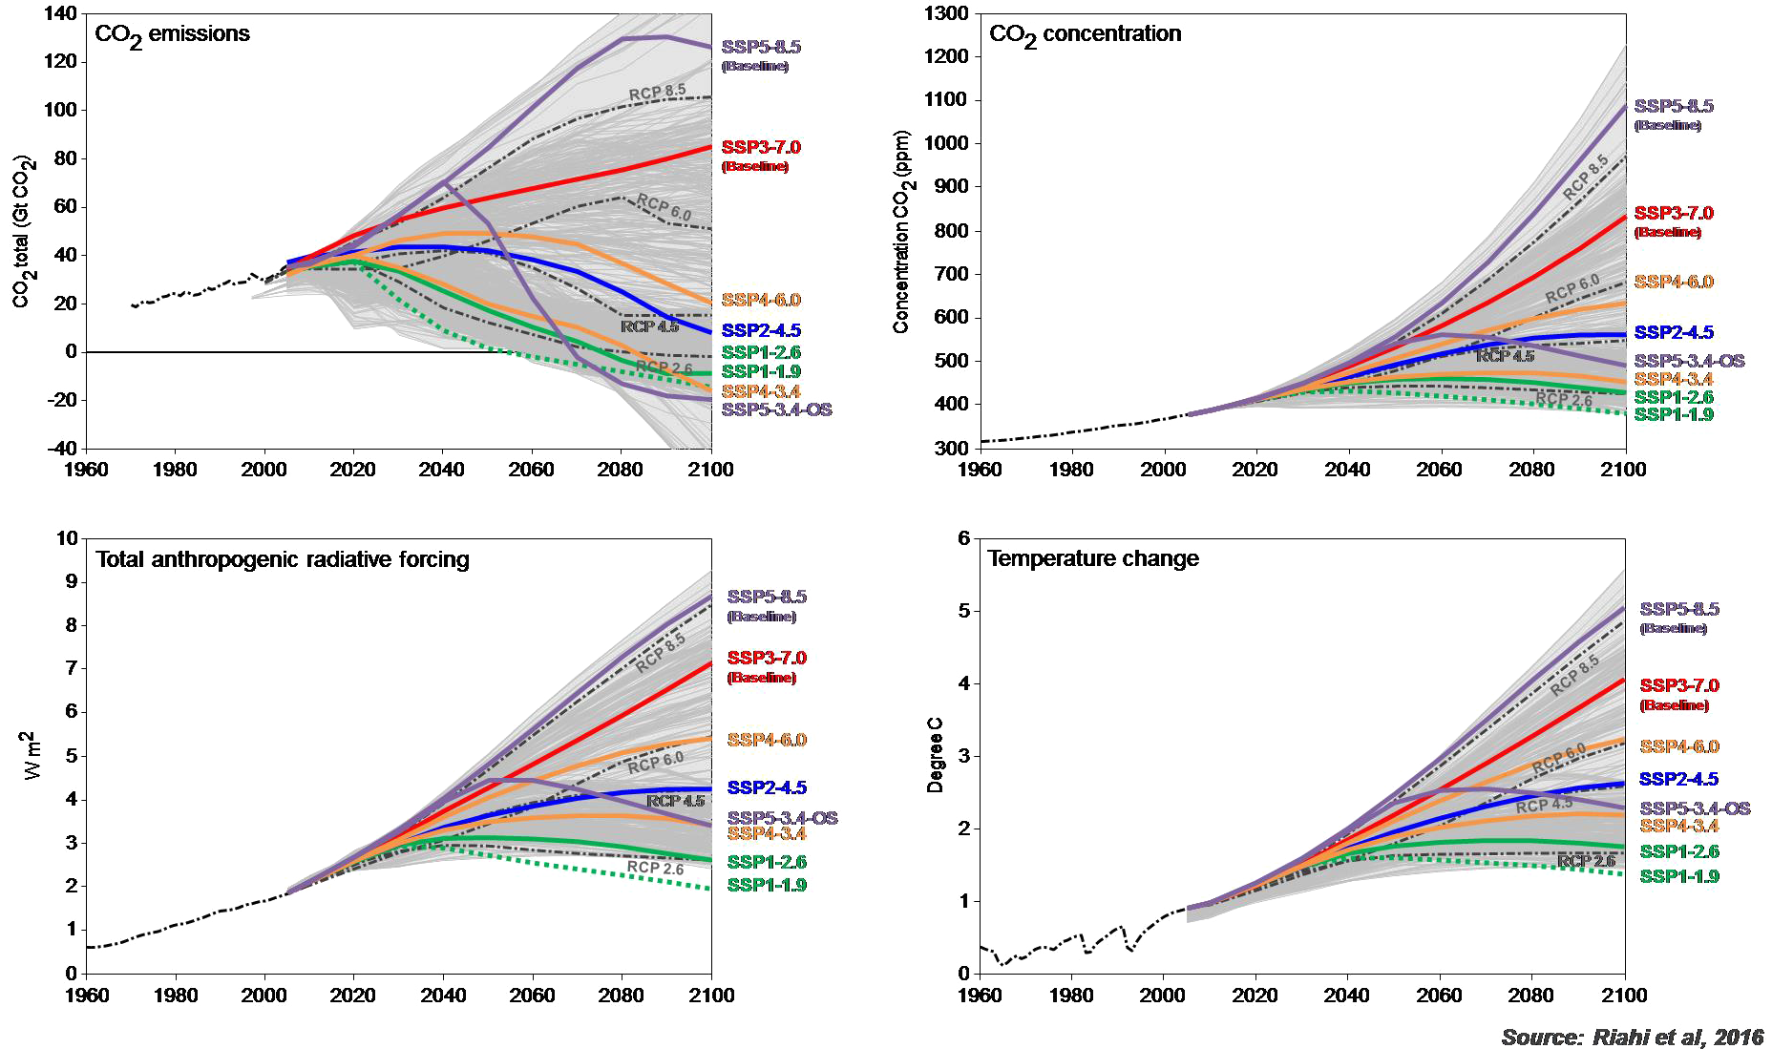
CO₂ emissions
Baseline scenarios SSP3-7.9 and SSP5-8.5 highest but unrealistic
SSP5-3.4 – overshoot, goes high but decreases later

Slide 29
Mean global temperature
SSP5-3.4 – overshoot, emissions go high but decreases later but
Temperature still high

Slide 30
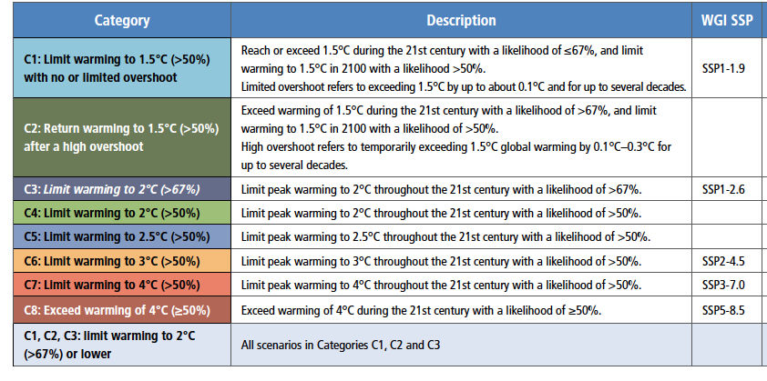
SSPs and global temperature targets

Slide 31
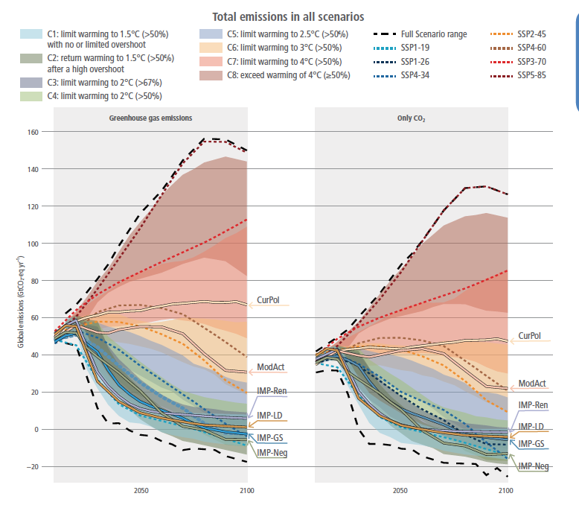
SSPs and global temperature targets

Slide 32
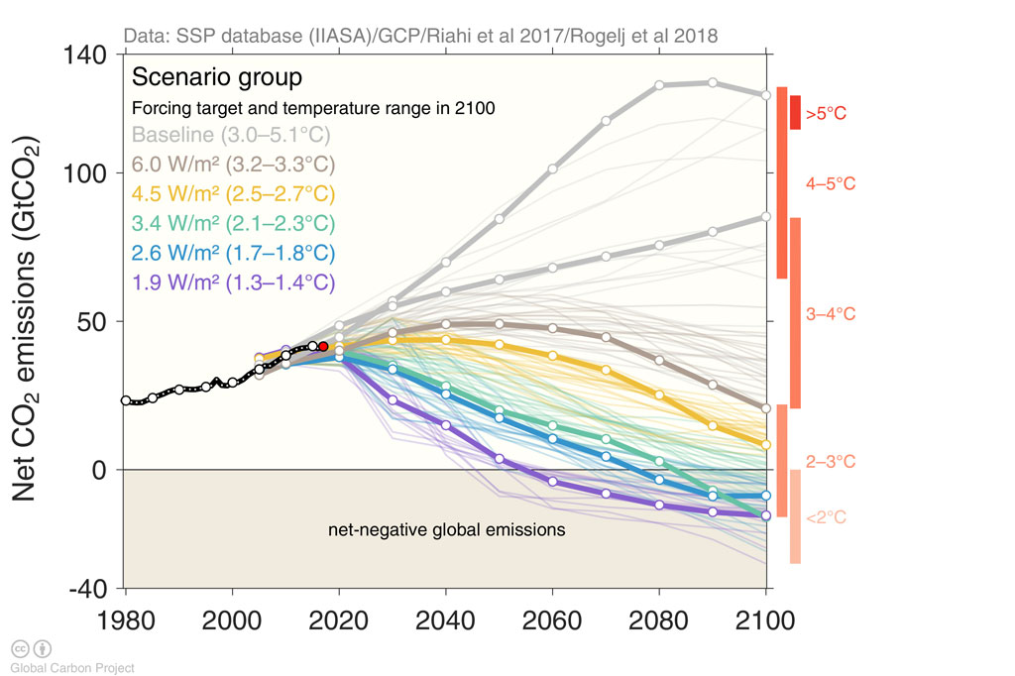
SSPs and global temperature targets

Slide 33
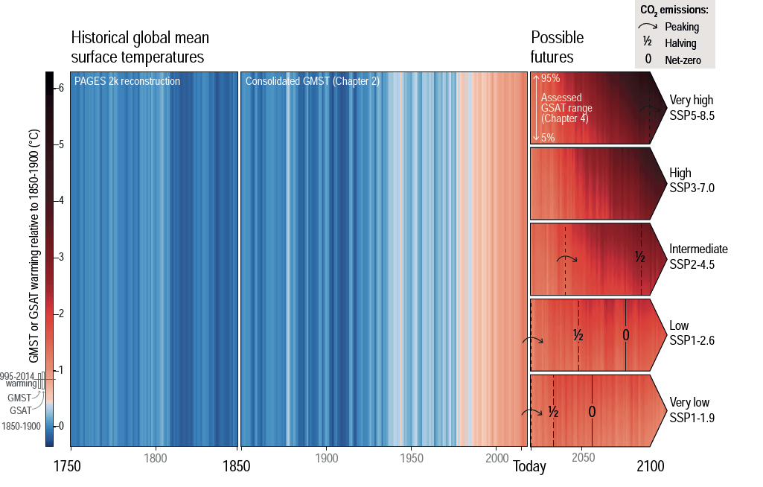
Notes:
IPCC AR6 WG I, chapter 1 Figure 1.245

Slide 34

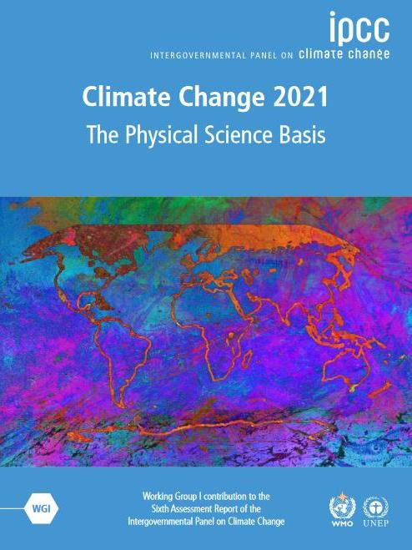
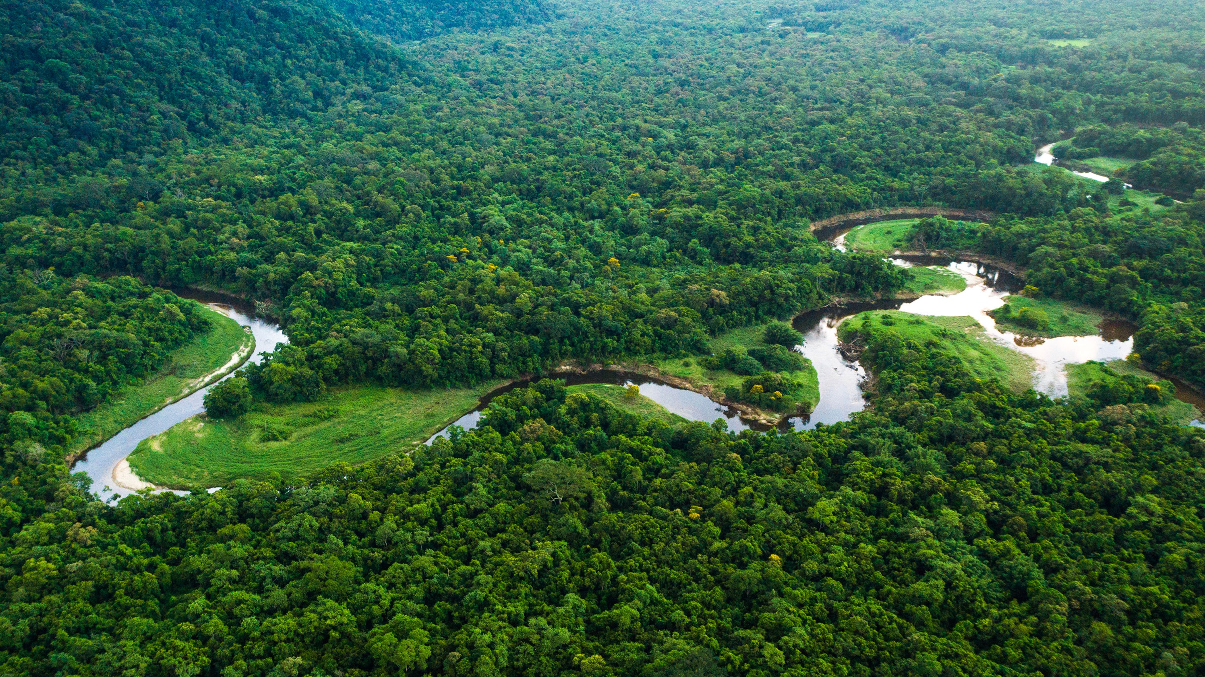

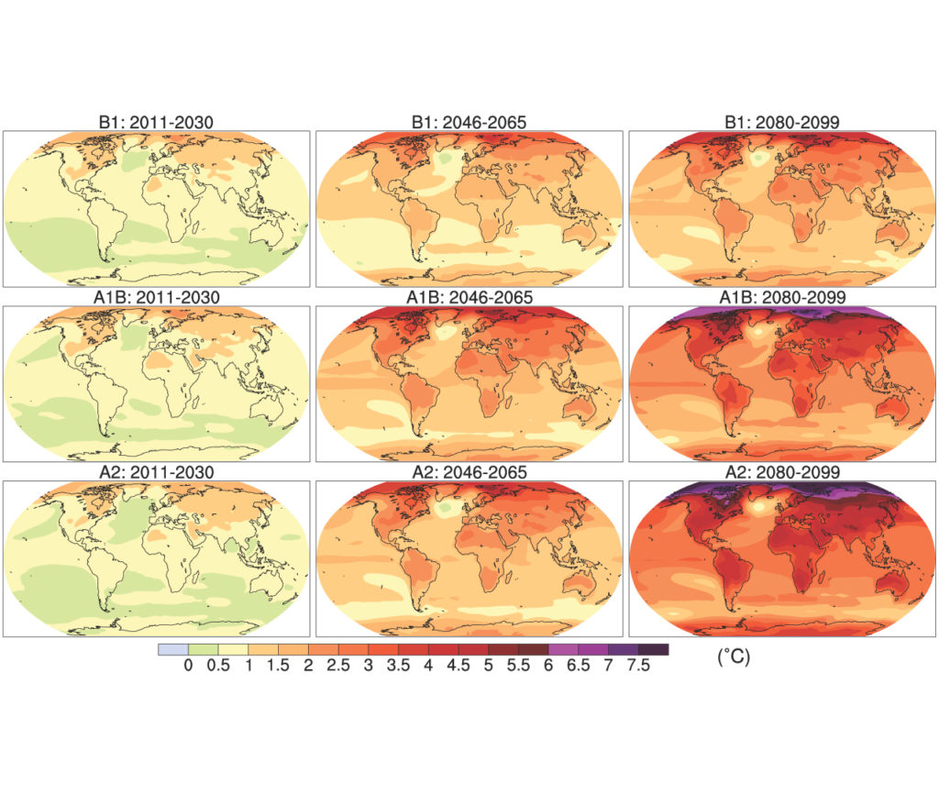
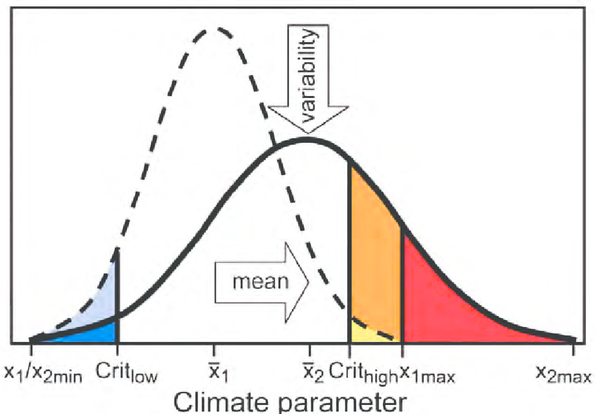
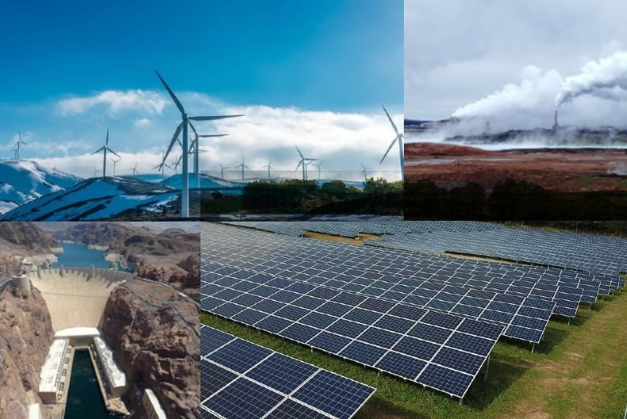
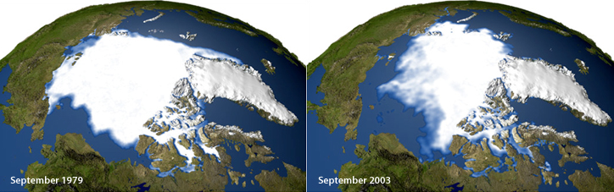
Atmosphere
Climate fundamentals
Predicting climate
Atmosphere
Global C cycle
IPCC report
Earth system models
Climate impacts
Climate solutions
Extreme events
Tipping points
Sea ice, ice caps,
Energy
Mitigation
Nature-based solutions

